Slide 1
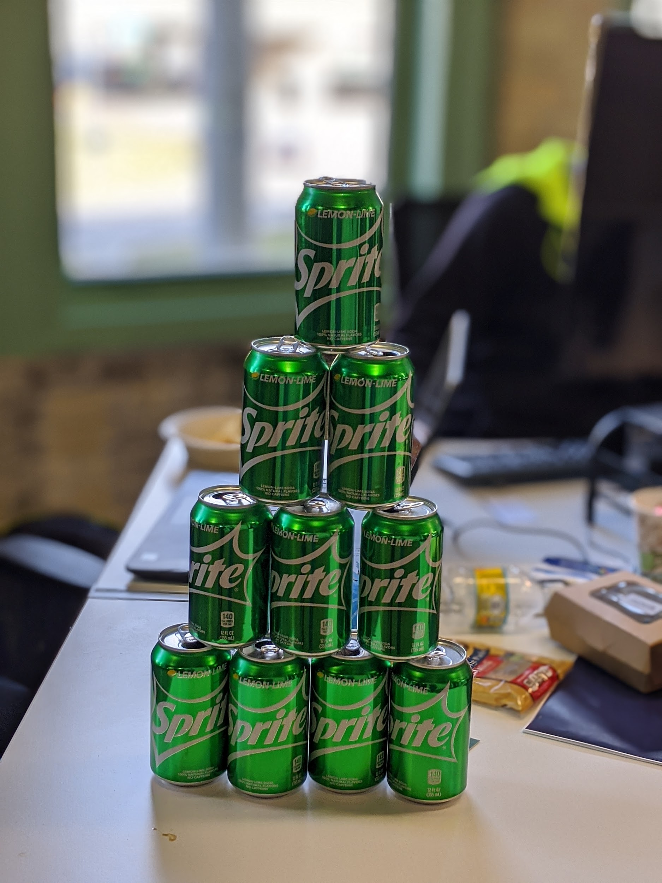
Team Sprite
Deepak Babu, Marlowe Fulton, Jack Gordon, Abraham Lemaitre

Slide 2

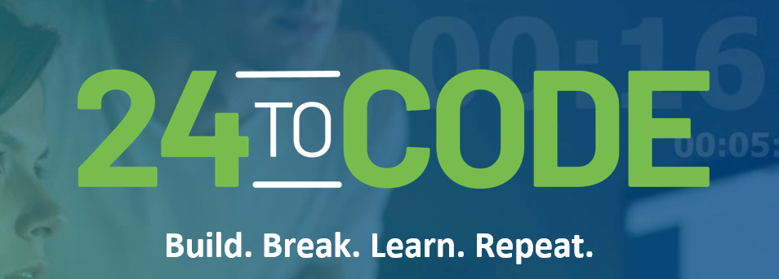
Skills Required:
No coding experience is necessary. We encourage individuals to leverage their innovative and problem-solving skills.
What we provide:
FOOD! - Pizza, snacks and Red Bull
Why We showed up …
Opportunity to Learn!!

Slide 3
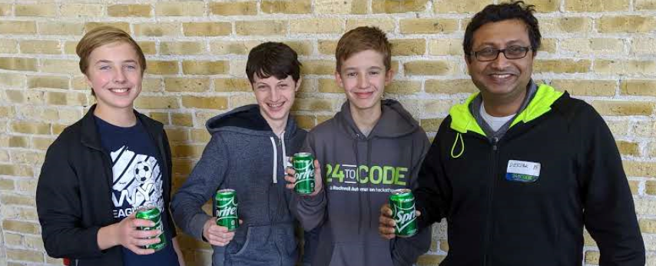
Who we are ..
We Love SPRITE!
Pick and Place
HS Junior
Sophomore
Sophomore
Business/Sales

Slide 4



In last 24 hours,
WE Accomplished …..
Analysed, organised, and developed a large, real-world dataset
Built a Deep Learning Model
WE Learned…..
Learned about the process of data science
Learned how to use Power BI to visualize data
Learned Python (Marlowe, Abraham)
Learned about how Rockwell implements IIoT
Also went through 20 cans of sprite, 190g of sugar per person, which is nearly 400% of recommended daily dose of sugar

Slide 5
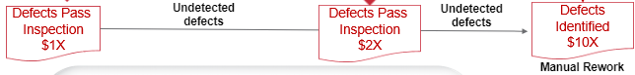
Business Value
Predicting anomalies before they happen
Allows company to minimize losses due to errors
With 1800 nozzles running, lost revenue adds up quickly

Slide 6
Our Process
Understand Business Context
Prepare Data
Develop Model
Model Tuning
Iterate
We used simplest of tools. Slept very little…

Slide 7
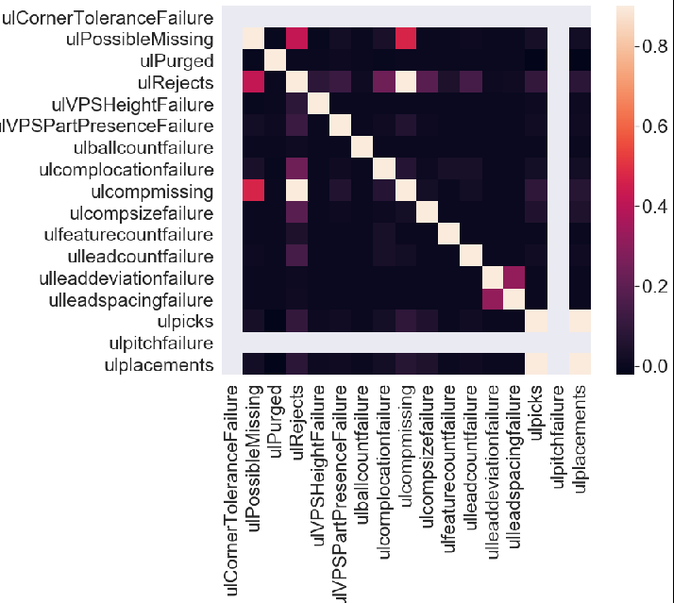
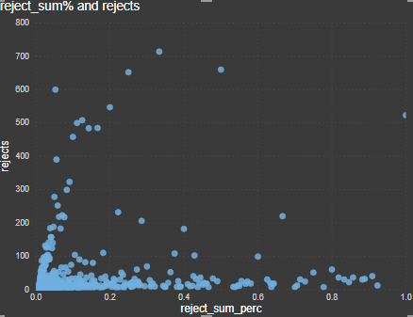
Preliminary observations
User Scatter Plots, HeatMaps to understand the nature of data
60k+ errors (picked, placed, and rejected don't add up) - Importance of data cleansing
Significant variables

Slide 8
The Model
These have increased accuracy in this application as we are handling sets of sequential data, and attempting to find and predict patterns
We used a Deep Learning Recurrent Neural Network;
MEAN SQUARED ERROR(MSE) - 7.5
LSTM, 50 Epochs, ADAM optimizer, 2 Hidden Layers, Data Set Split 80/20,

Slide 9
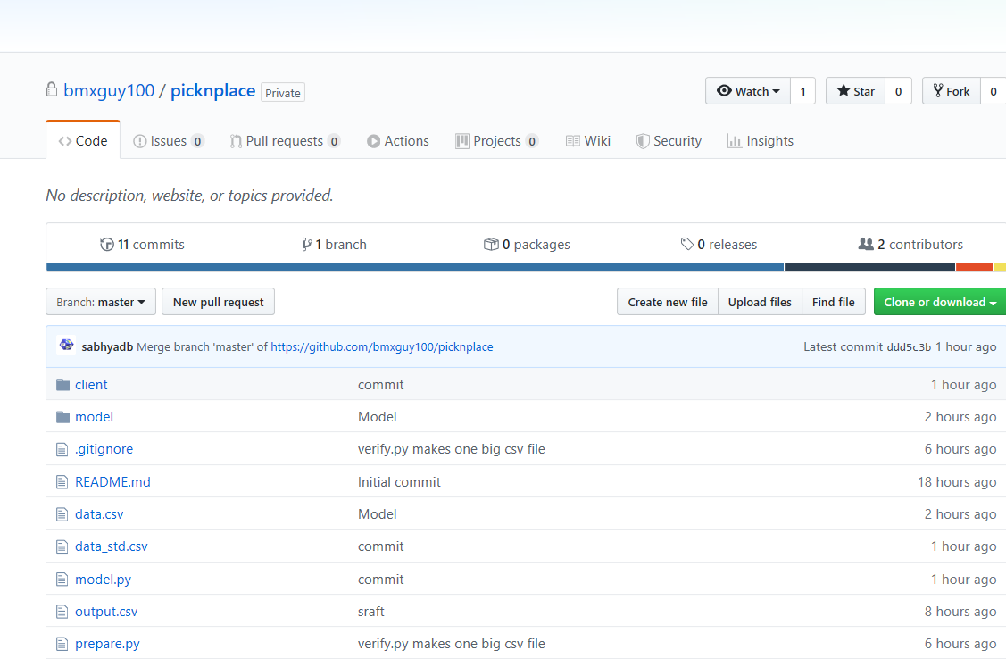
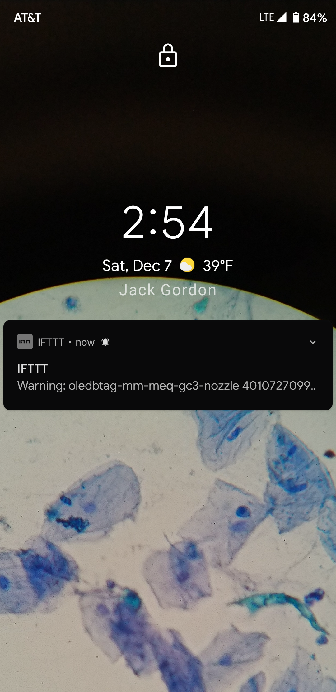
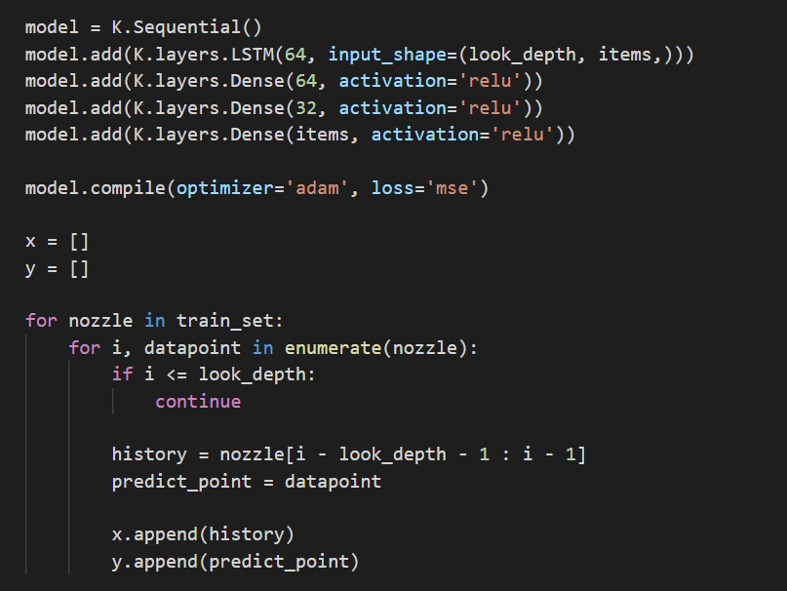
Tech Stack
Notification
Model Development
IDEs
Python, TensorFlow, Keras
VSCode, Spyder, Power BI, Github
IFTTT ( If this then that)

Slide 10
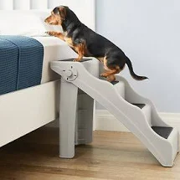
Next Steps
Develop complete UI
Further Optimize Model Parameters
Larger datasets with better Infrastructure

Slide 11
In Closing…
Learning
Python
DS
Technology
Model Development
IIOT
Power BI
Technology Solution Development
Design
Completion / Value Delivered

